Slide 1



Slide 2
Netflix Recommendation System

Slide 3




Presenters Names
Tasmia M
Pankaj Varma
Hitesh Gohad
Suraj Kadam

Slide 4

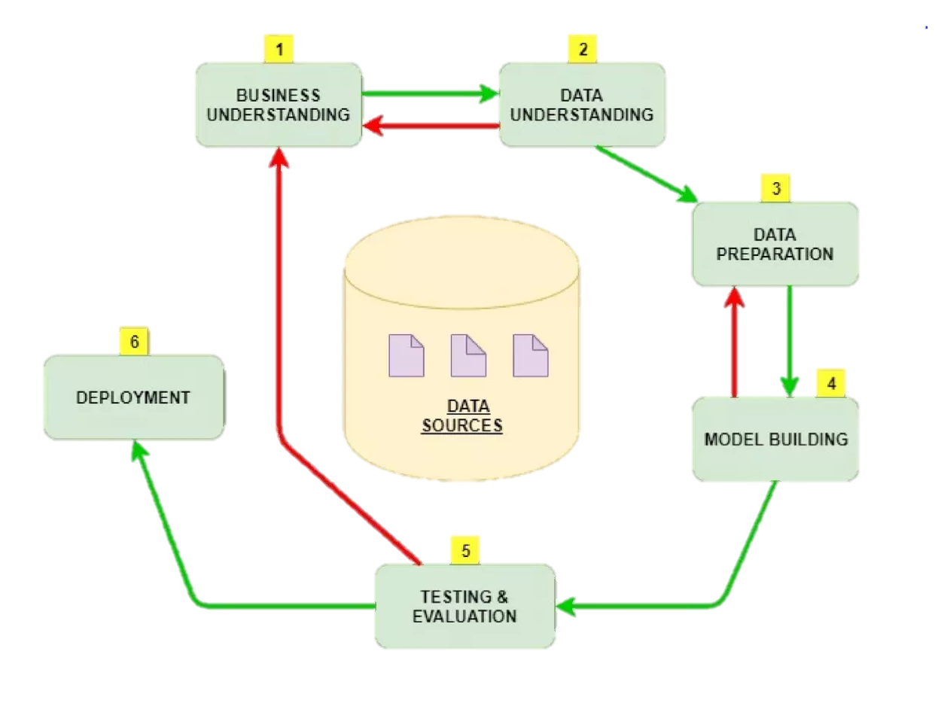
4
Project
INTRODUCTION
97% for you
16+
2022
This project represents a strategic approach to harness the power of data mining and clustering for content recommendation systems. By enriching the dataset with newly engineered features and applying clustering techniques, we aim to provide actionable insights that could significantly enhance Netflix's recommendation engine. Ultimately, the project seeks to contribute to Netflix's ongoing efforts to captivate and retain subscribers by delivering a highly personalized and satisfying viewing experience.
Skip

Slide 5

Subtitle
Exploratory
Data Analysis
97% for you
16+
2022
In our EDA, we're looking closely at the numbers, what viewers say about shows, and what's popular on Netflix. We're checking out which types of shows are watched the most and when new ones come out. Our goal is to find cool new ways to help Netflix suggest shows and movies that you'll really like, making sure there's always something great for you to watch.
Play

Slide 6
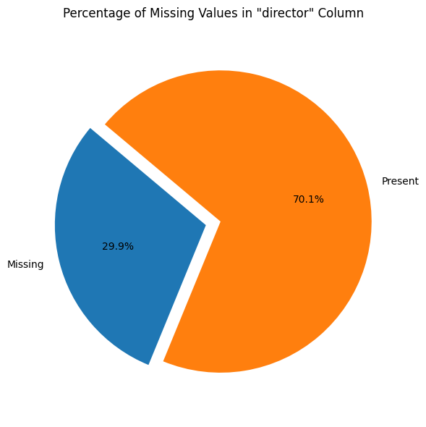
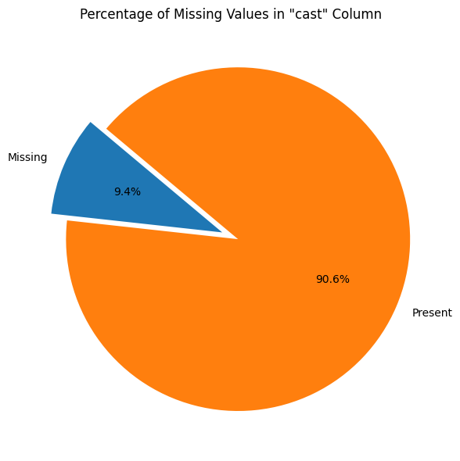
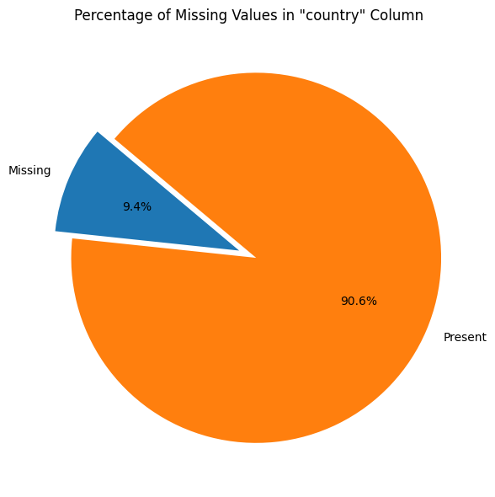
Missing Values in Dataset
4
Percentage of Missing Values in “director” Column of Dataset
Percentage of Missing Values in “cast” Column of Dataset
Percentage of Missing Values in “country” Column of Dataset

Slide 7
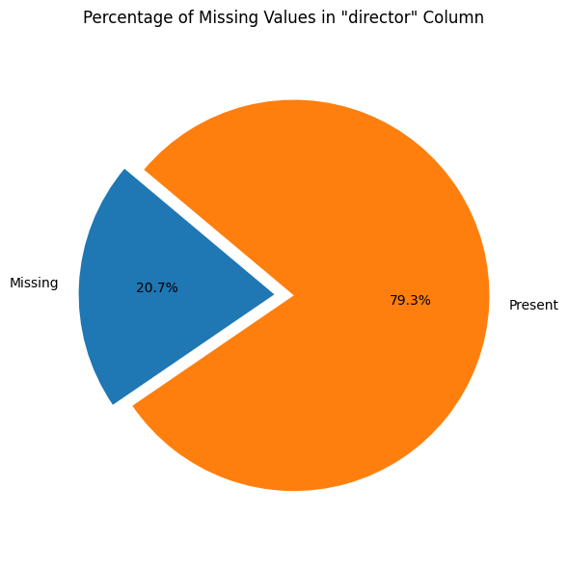
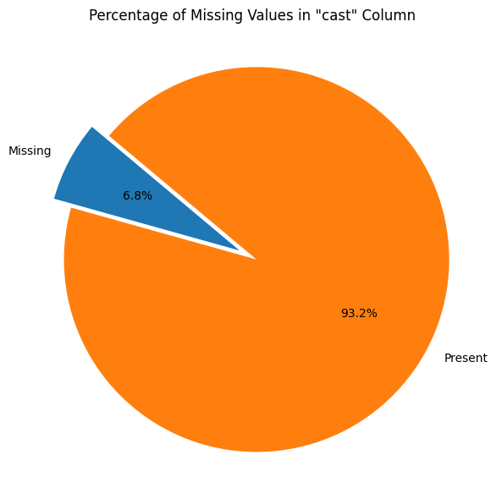
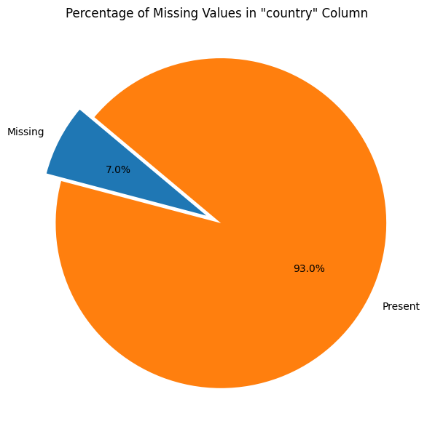
Handling Missing Values
4
Filled the missing values by fetching real-time data from Wikipedia such that the percentage of missing values for “director” column has changed to 20.7% from 29.9%
Filled the missing values by fetching real-time data from Wikipedia such that the percentage of missing values for “cast” column has changed to 6.8% from 9.4%
Filled the missing values by fetching real-time data from Wikipedia such that the percentage of missing values for “country” column has changed to 7.0% from 9.4%

Slide 8
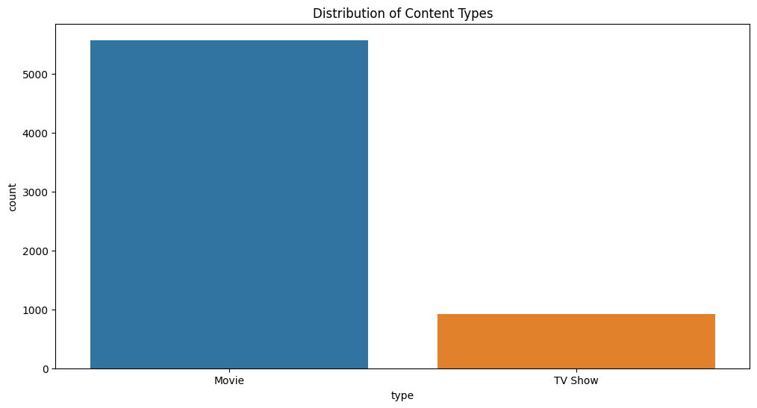
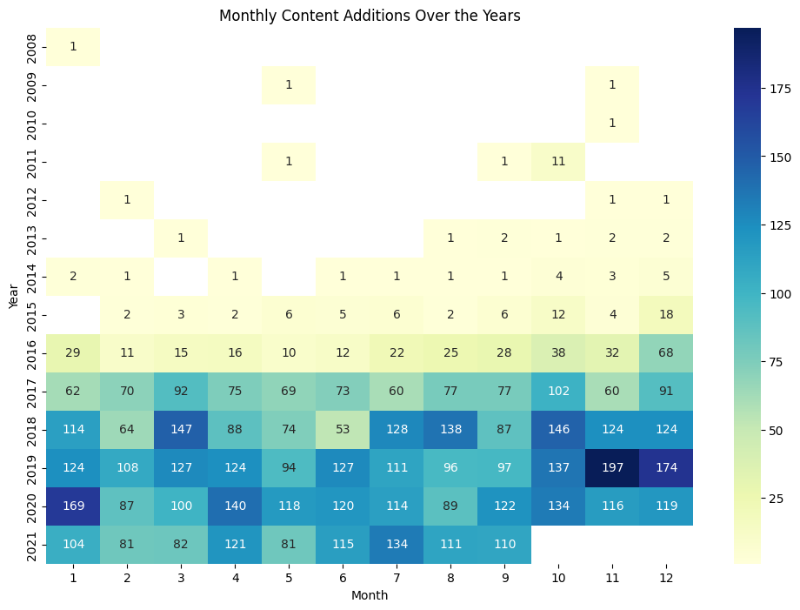
4
Depiction of number of Movies vs TV Shows
Visualization to show the addition of Monthly Content over the Years

Slide 9
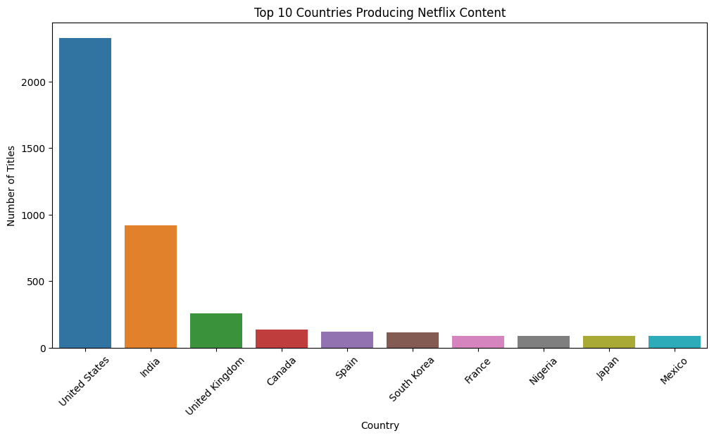
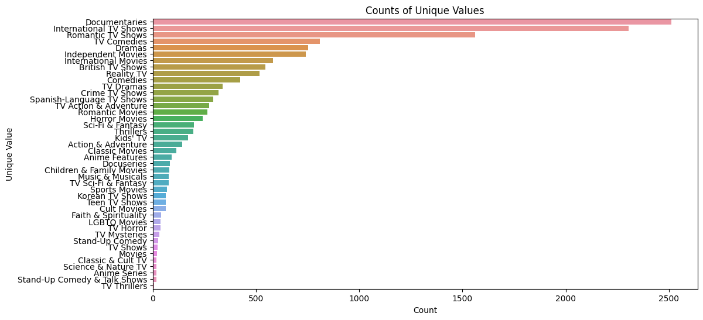
4
Bar chart titled "Top 10 Countries Producing Netflix Content," showing the United States as the leading producer with over 2000 titles, followed by India and the United Kingdom.
Horizontal bar chart showing the "Counts of Unique Values" in different content categories on Netflix, with 'Documentaries' and 'International TV Shows' being the most common.

Slide 10

4
Subtitle
Model Building
97% for you
16+
2022
For building the model, we're creating a smart system that learns from what you watch and enjoy on Netflix. It'll notice the kind of shows and movies you love and find others just like them. This way, Netflix can recommend the perfect match for your next binge-watching session, keeping your watchlist exciting and fresh.
Play
+

Slide 11
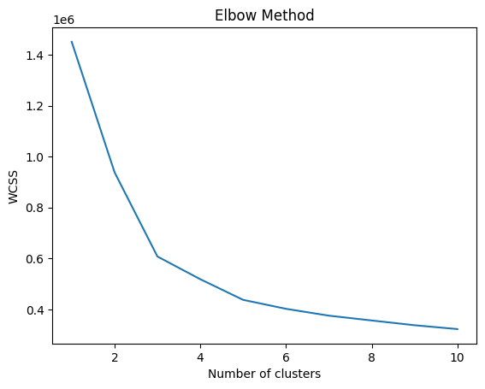
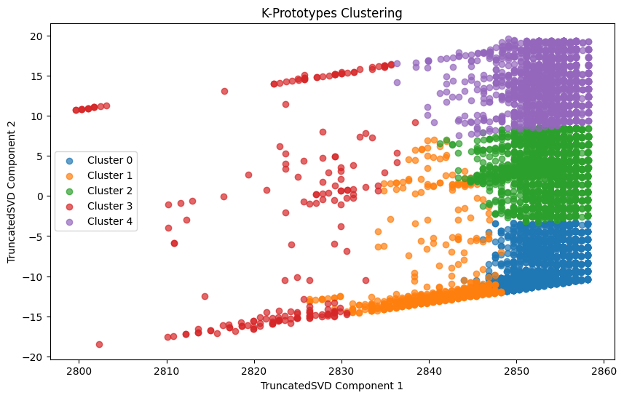
4
A line graph representing the "Elbow Method," which is used to determine the optimal number of clusters for K-means clustering; the curve suggests a potential elbow point at around 5 clusters.
A scatter plot labeled "K-Prototypes Clustering," displaying data points in five distinct clusters, visualized with different colors, plotted against two components derived from TruncatedSVD.

Slide 12

4
Subtitle
Deployment
97% for you
16+
2022
For our Netflix Recommendation Project, we're launching a clever tool that tunes into your unique tastes. As soon as you hit play, it gets to work, lining up a custom playlist of shows and movies just for you. Kick back and enjoy — Netflix is about to get even better at finding your next favorite story.
Play
See More

Slide 13
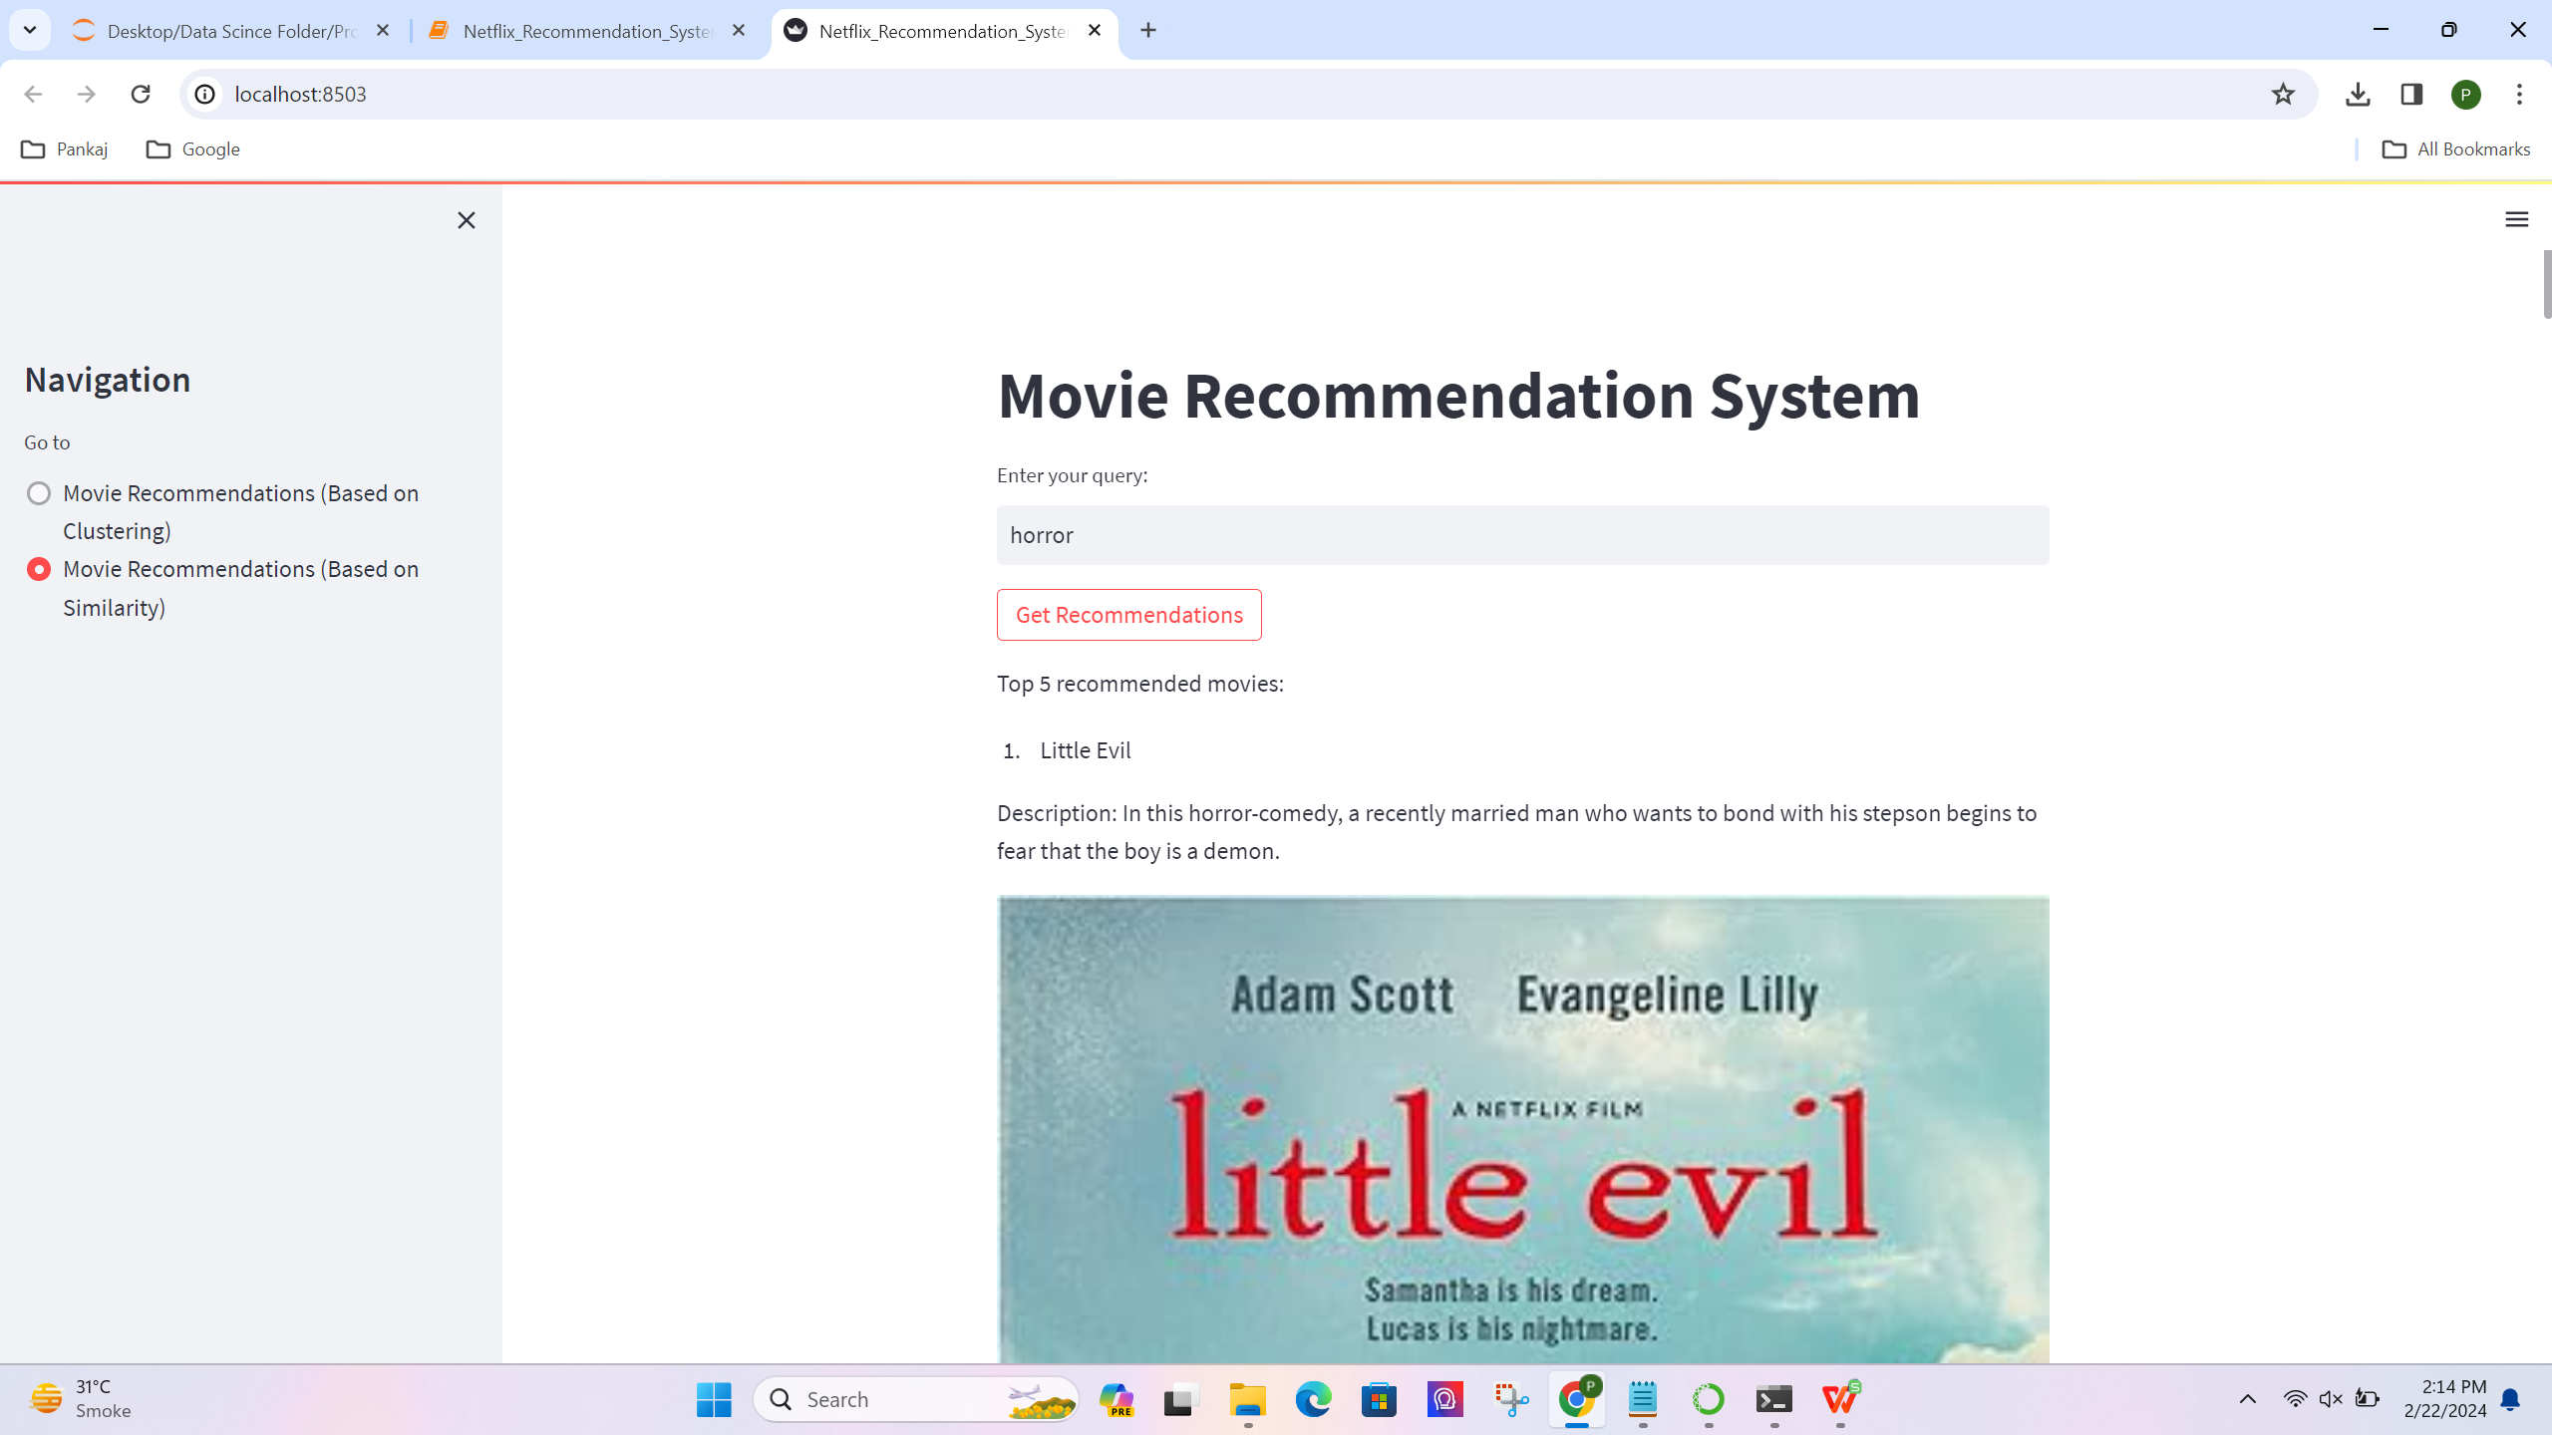
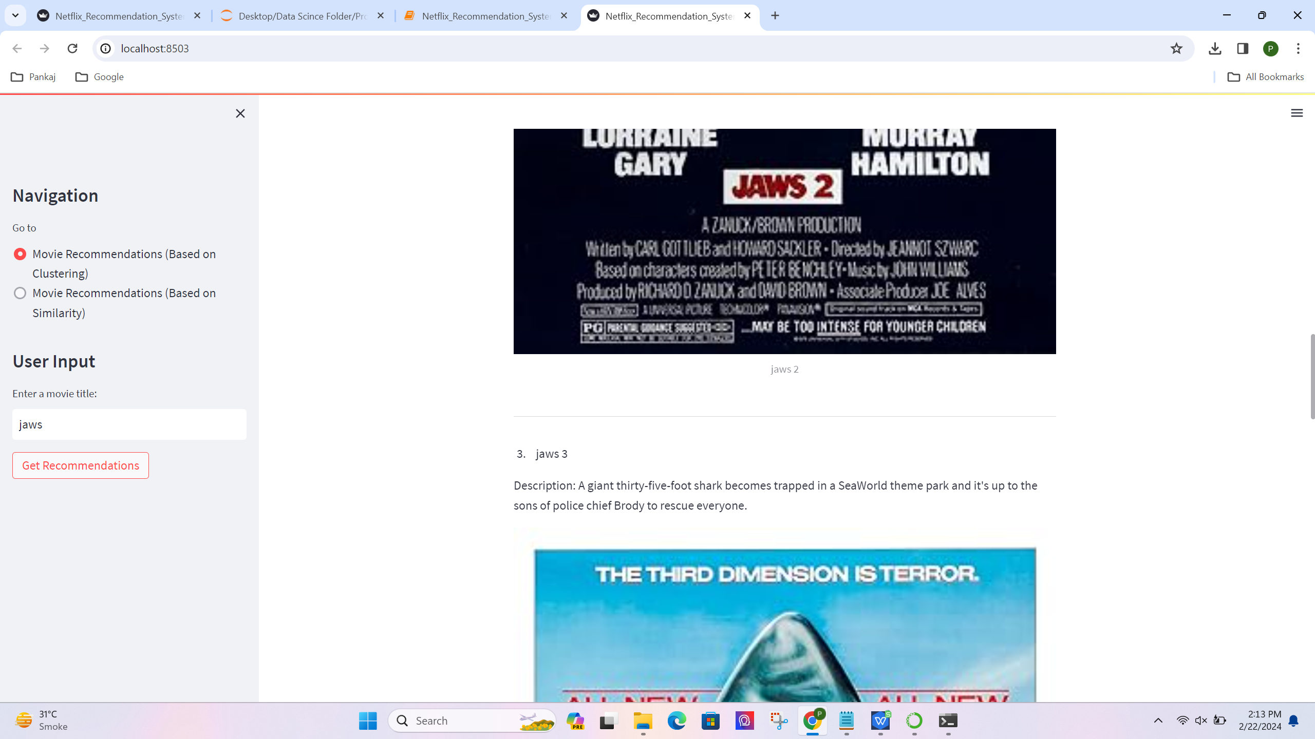
4
The system lets users type in any words related to movies they're interested in, then searches through its movie database to find matches. It uses cosine similarity that scores how similar the movies are to the words provided and recommends the closest matches, along with some details about each movie.
Upon receiving a movie title as input from the user, the system locates this movie in its collection and finds a set of movies that are grouped together because they're liked by users with similar preferences. It then uses a K-proto clustering algorithm to recommend other films from this set, suggesting these films might interest the user due to their similarity to the initial choice.

Slide 14
Challenges Faced
Missing Data: Tasked with addressing more than 30% missing information to ensure accurate predictions.
Algorithm Choice: Selecting the appropriate algorithm for the problem.
Model Deployment: Overcoming challenges in moving models to production.
Resource Management: Balancing time and resources within project constraints.
Data Integrity: Ensuring data quality to maintain model performance.
Model Scaling: Addressing challenges in scaling models for larger datasets.
Next
Studio
Production Company (distributor)
Production Company (producer)
Director (usually as “A ‘Director’ Film”)
FILM TITLE
Main Cast
Supporting Cast
Casting Director
Composer
Costume Designer
Associate Producer(s)
Editor
Production Designer
Cinematographer
Executive Producer
Producer
Writer(s)
Director (Second reference)

Slide 15
Challenge Mitigation
Data Integration: Leveraged real-time Wikipedia data to compensate for the 30% missing information.
Best Algorithm: Experiment with different models to find the most suitable one.
Streamlined Deployment: Use tools for consistent, automated model updates.
Resource Efficiency: Prioritize key tasks and use resources wisely.
Clean Data: Keep data accurate and consistent through regular checks.
Handling Big Data: Use advanced methods to manage large datasets effectively.
Next
Studio
Production Company (distributor)
Production Company (producer)
Director (usually as “A ‘Director’ Film”)
FILM TITLE
Main Cast
Supporting Cast
Casting Director
Composer
Costume Designer
Associate Producer(s)
Editor
Production Designer
Cinematographer
Executive Producer
Producer
Writer(s)
Director (Second reference)

Slide 16
thanks

